Slide 1

VISUAL REPORT INTEGRA Project
Team Red:
Ivan Hristov
Hanna Upornikova
Anh Hoang
Zainab Arowolo

Slide 2
Introduction
This report documents an investigation undertaken by our team to address the challenges faced by international students at the Porvoo campus in integrating into Finnish society and work life.
By gathering insights from companies through interviews and gathering feedback from students via surveys, we aimed to understand and identify what challenges a smooth integration. Equipped with these insights, our team started on a journey of brainstorming, experimenting, and testing to develop innovative solutions tailored to the specific needs of international students at the Porvoo campus.
This report provides an overview of our research methodology, main findings, and suggested interventions. We believe that the solutions outlined here will not only improve the integration experience for international students but also enrich the academic and professional environment in Finland.

Slide 3
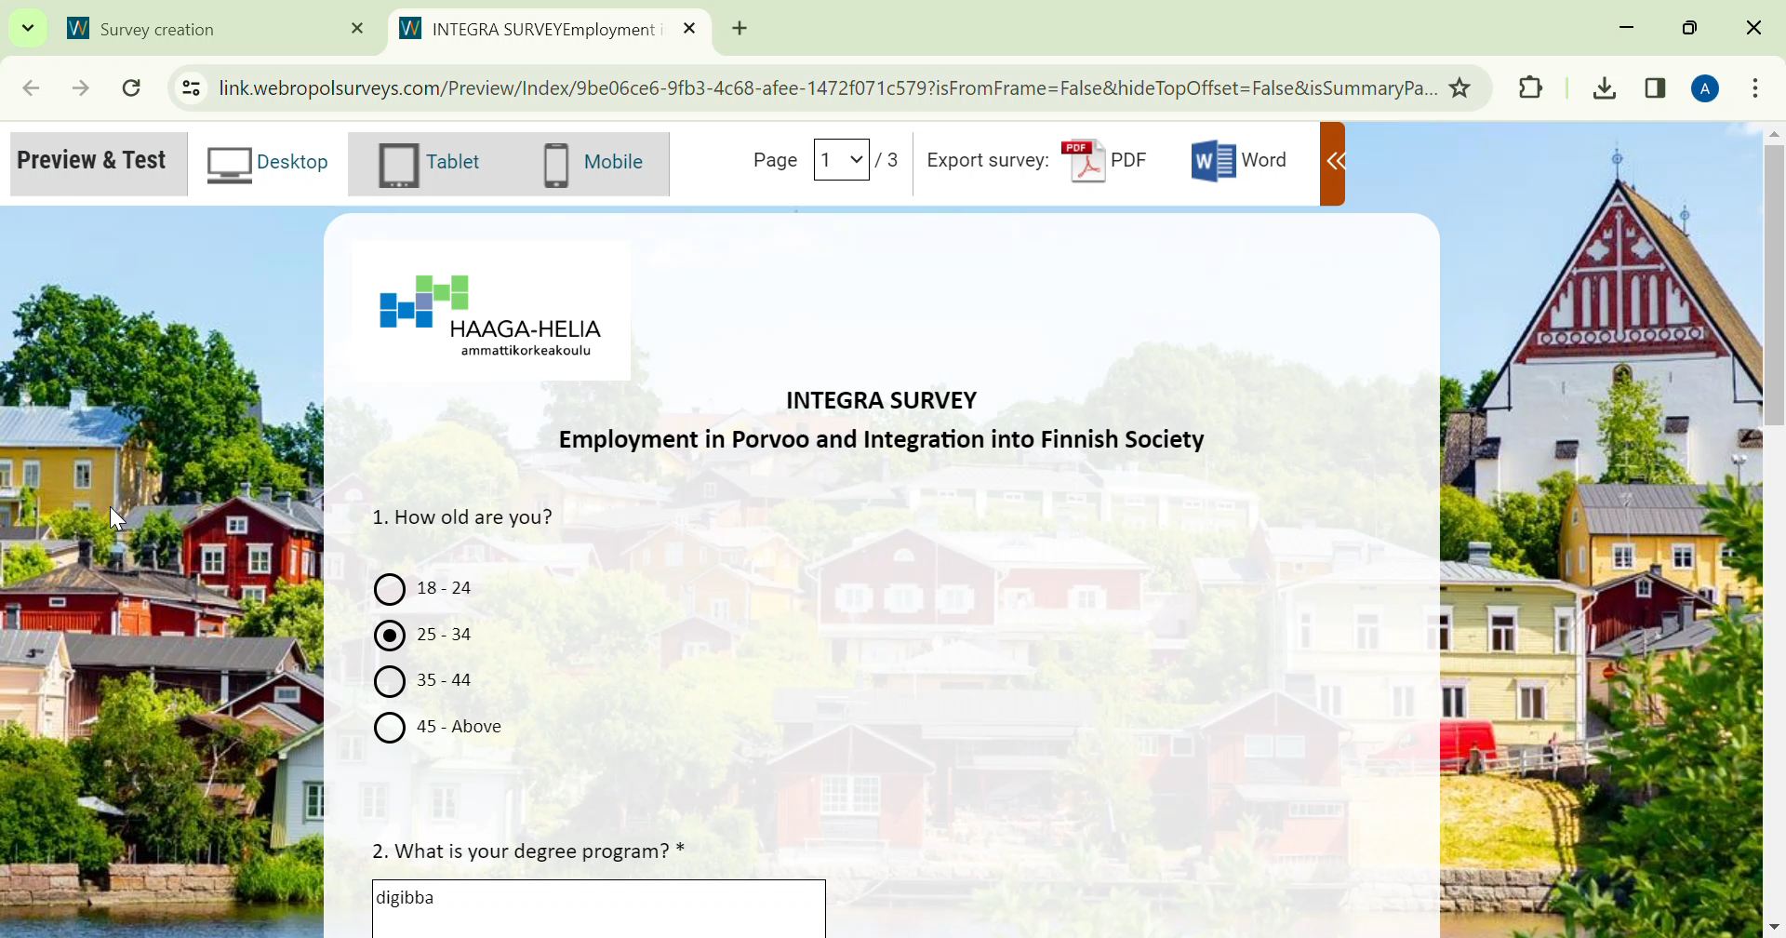
Insight Gatherings
Interviews with local companies
The goal is to learn about employers’ perspectives towards hiring international students, their hiring processes, expectations, advice and suggestions for application and interview, and plans for future.
Survey to international students from DIGIBBA, AVIBBA and STEM
The goal is to learn about interntional students’ experiences with job hungting, application process, suggestions for improving Haaga-Helia services, and plans for the future,

Slide 4


Initial Challenges
The challenges are drawn based on the interviews and survey
From employers’ perpectives
From students’ perpectives
There are not many international companies in Porvoo that hire for English-speaking roles
Some specific roles strictly requires Finnish skills
Language barriers
Lack of part-time jobs and internship programs
Some companies may not know where and how to connect with international students
Difficulties broadening their network and integrating into Finnish soceity
Some companies have very little experience hiring international students

Slide 5
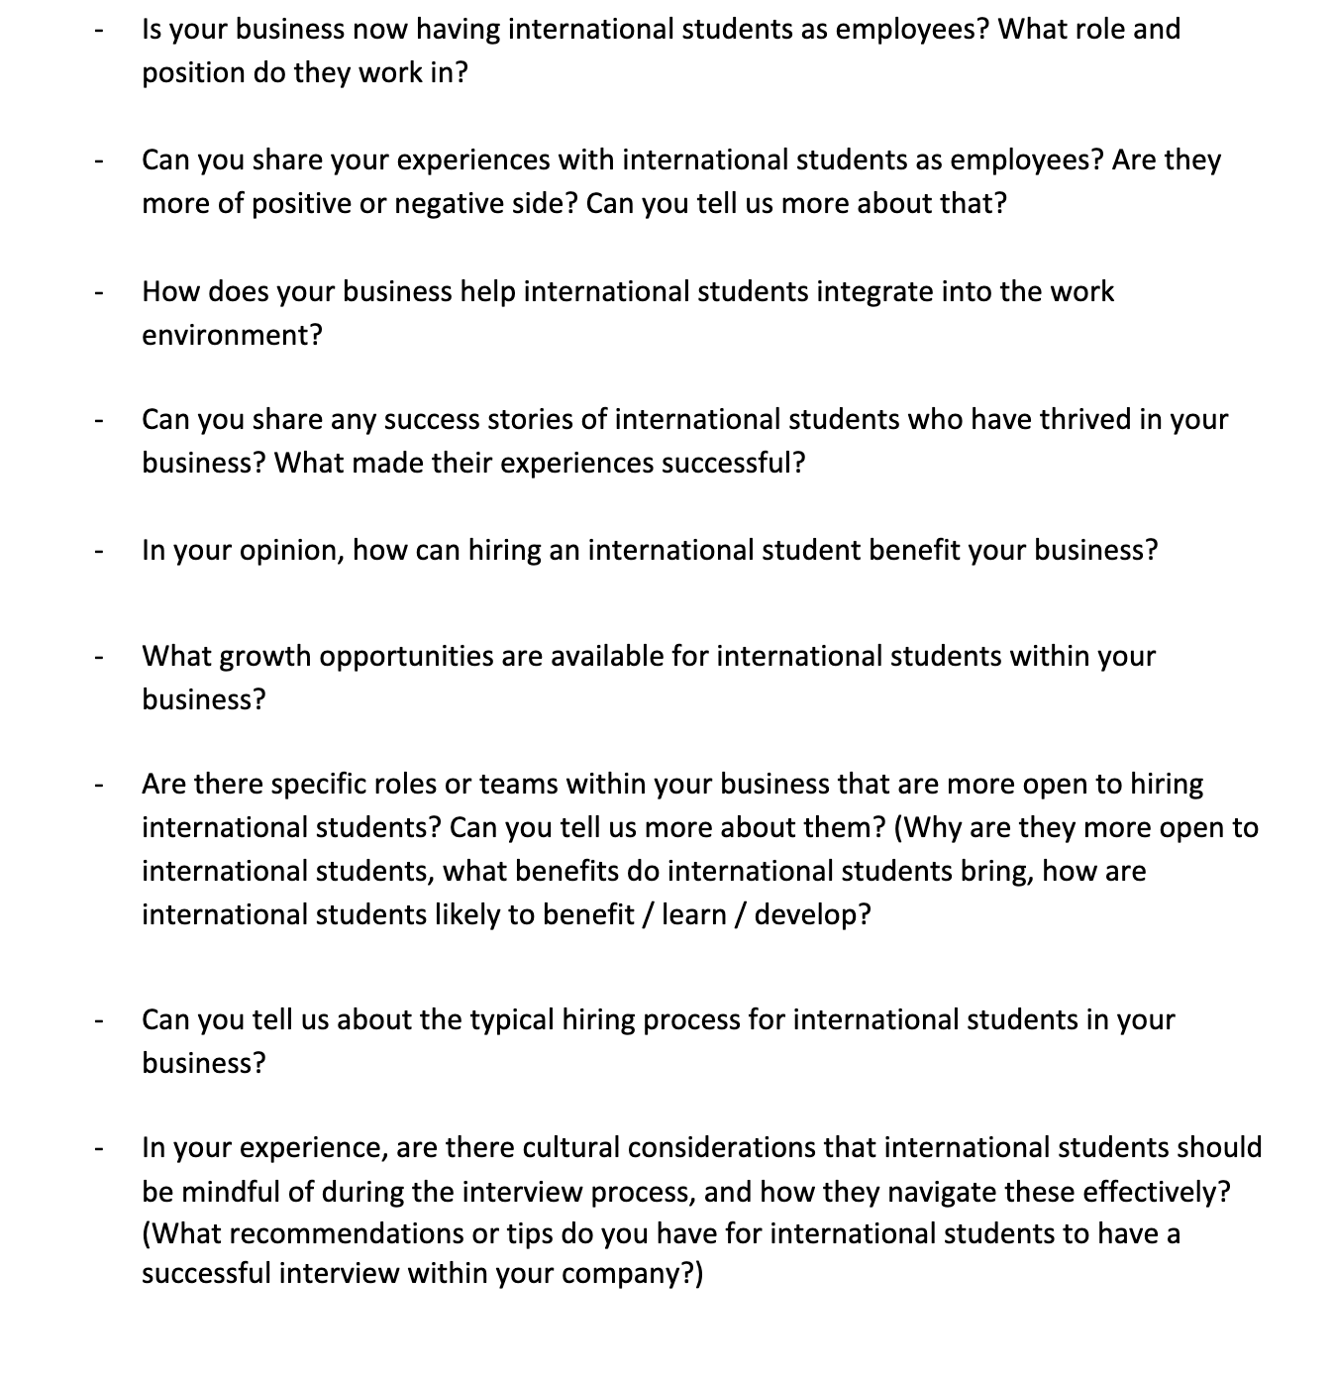
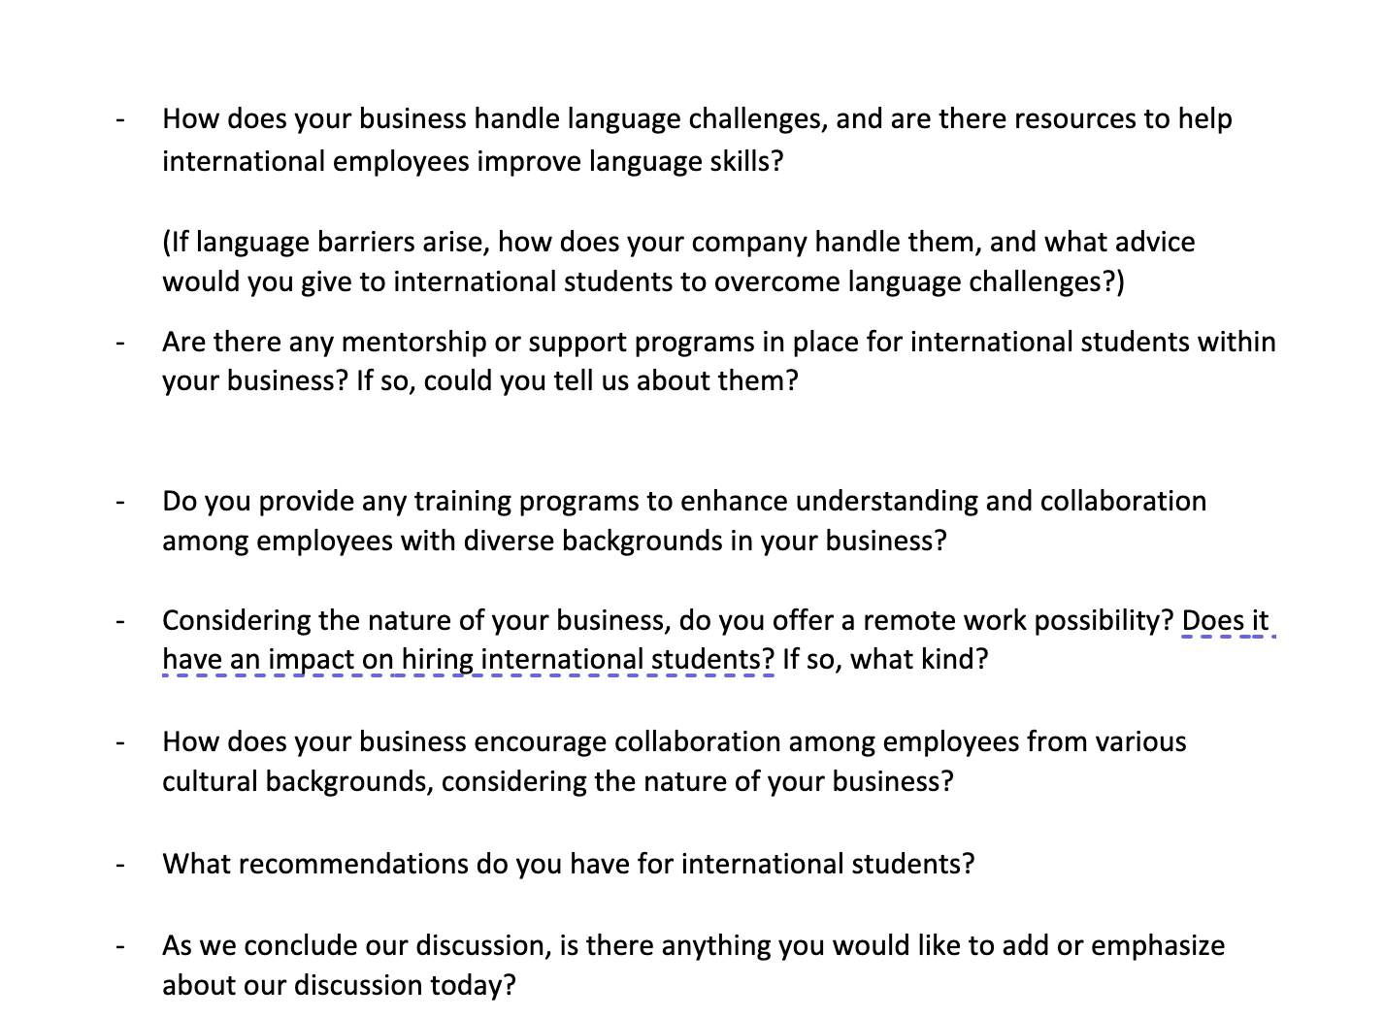
Interview Process
To help international students at Porvoo Campus settle into Finnish life, excel in their studies, and find jobs quicker, we conducted interviews to learn from companies. We covered a range of topics including how they hire international students, their experiences working with them, how they help them fit into their workplaces, success stories, why they like hiring international students, what opportunities they offer them, any special roles or teams for them, cultural issues, language barriers, and more. We had a set of questions to guide us, but we also went with the flow and asked about things that came up naturally during the interviews. We reached out to 8 companies but received a positive answer and interviewed only 4.

Slide 6
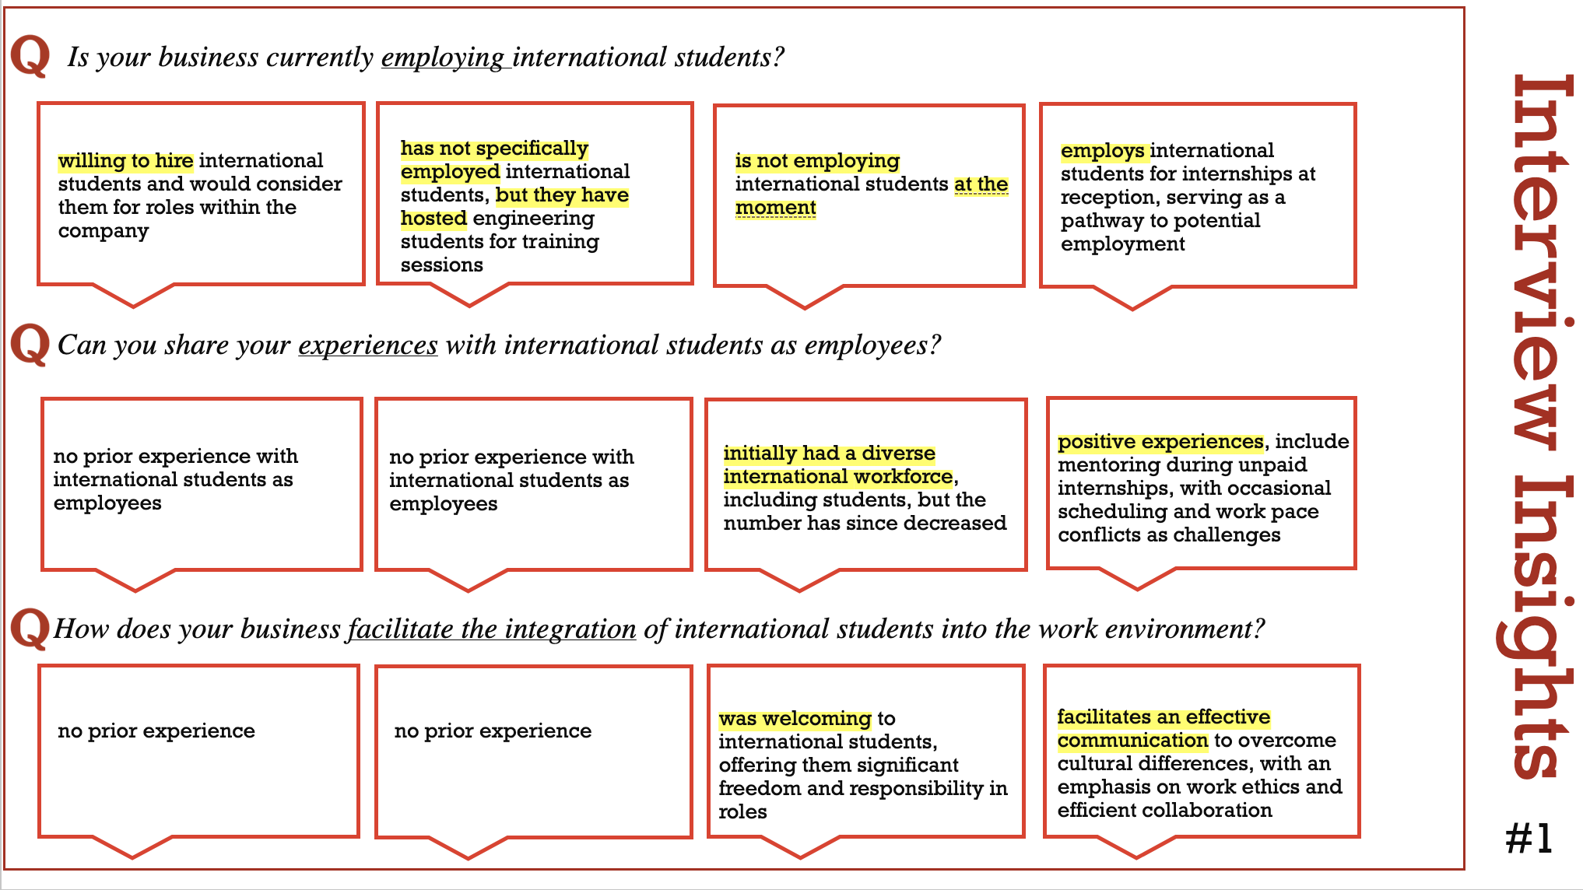

Slide 7
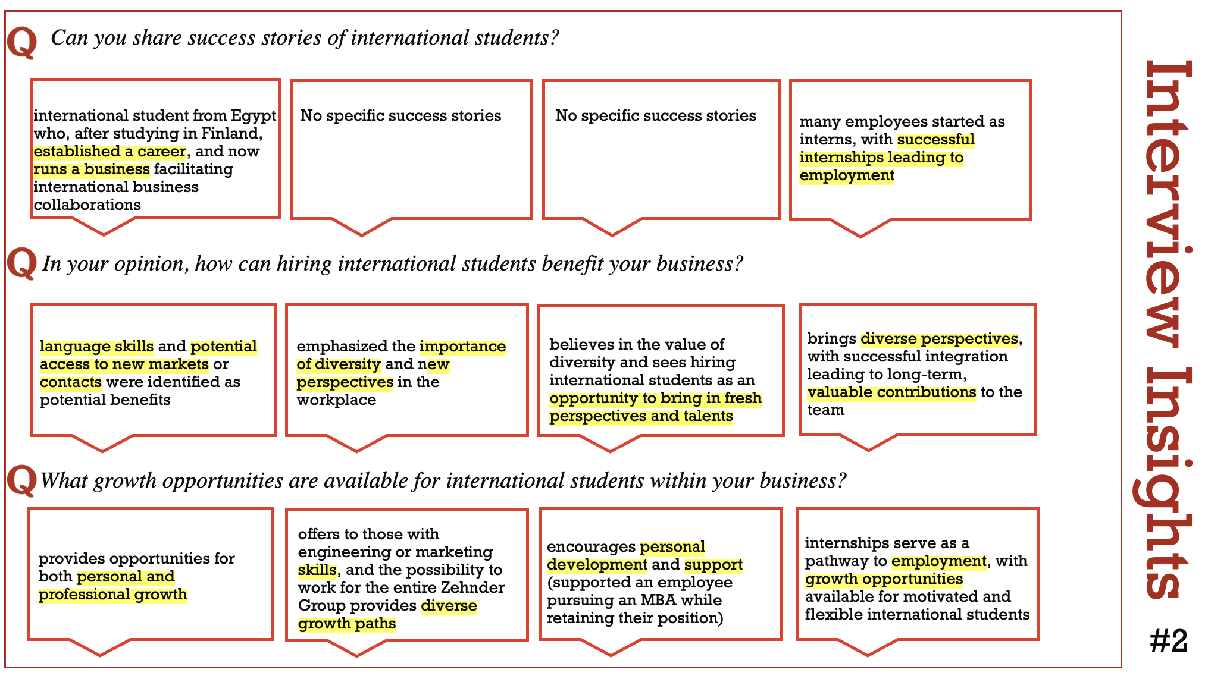

Slide 8
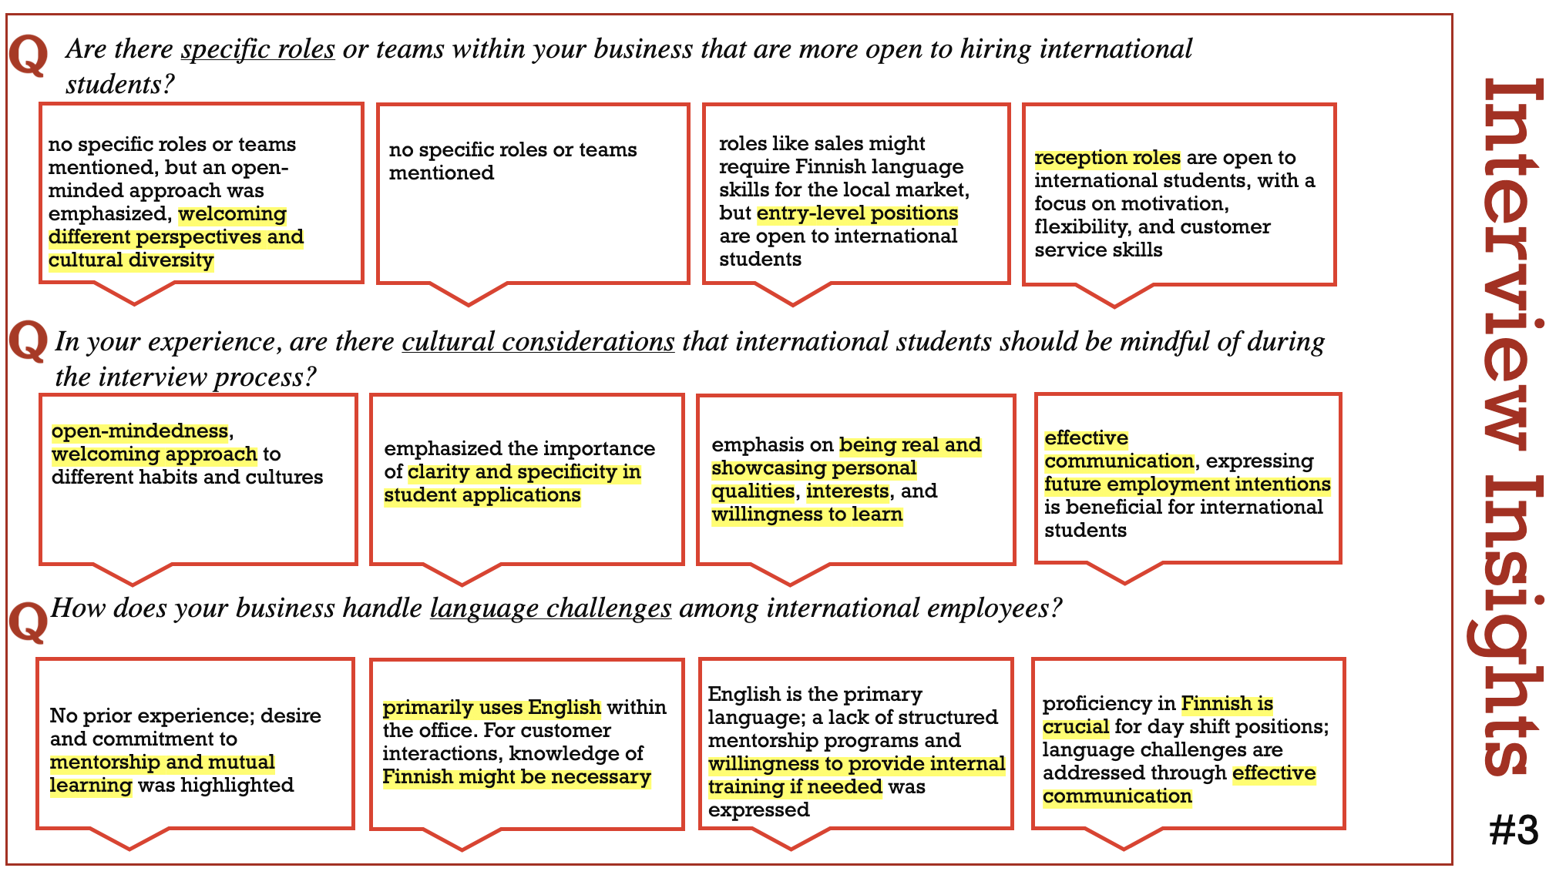

Slide 9

Hiring international students presents a unique opportunity for companies to enrich their workforce with diverse perspectives, cultural insights, and fresh ideas. Encouraging diversity promotes innovation and creativity within the company, ultimately driving business growth and success.
Knowledge of Finnish is considered crucial or at least recommended for finding a good job in Finland. However, there are companies in Porvoo that either use English as their primary language of business or offer positions within the company that don't necessitate knowledge of Finnish. Such positions are often in international sales, marketing, research and development, and technical fields. While many international students may have proficiency in English, which is commonly spoken in business settings, fluency in Finnish can significantly enhance job prospects, particularly for roles that require direct interaction with Finnish-speaking clients, customers, or colleagues.
Beyond language skills, employers prioritize qualities such as motivation, flexibility, open-mindedness, and a positive attitude when considering international student candidates. These attributes contribute to a dynamic work environment where individuals can thrive and contribute meaningfully to the company's goals.
A diverse work environment is crucial for fostering innovation and inclusivity, but it also presents challenges such as communication barriers and cultural misunderstandings. It is important to address these issues and establish a harmonious environment where every employee feels valued. Skilled leadership and inclusive strategies are essential.

Slide 10
Proactive communication plays a vital role in navigating the complexities of a diverse work environment. Encouraging open dialogue, active listening, and empathy helps foster mutual understanding and trust among team members, leading to smoother collaboration and conflict resolution.
Networking is emphasized as essential for success in business. International students bring with them diverse networks spanning different countries and industries, offering valuable connections that can open doors to new opportunities, partnerships, and markets for the company. Additionally, networking is also crucial for students aiming for a successful career. It provides opportunities for students to gain insights, advice, and mentorship from experienced professionals, helping them navigate their career paths more effectively. Moreover, networking allows students to build relationships with potential employers, increasing their chances of securing internships, job opportunities, and career advancement.
Overall, hiring international students is not just about fulfilling diversity quotas but is viewed as a strategic investment in the company's growth and competitiveness. By embracing diversity, fostering inclusive practices, and leveraging the unique perspectives of international students, businesses in Finland can position themselves for long-term success in an increasingly globalized economy.

Slide 11
Point of view statement: Local companies need to provide opportunities to international students because they need to build a diverse workforce and grow internationally.
Local companies can greatly benefit from providing opportunities to international students, as it offers several advantages beyond just filling positions. Firstly, it allows the companies to find diverse talents with unique perspectives, skills, and cultural backgrounds. This diversity fosters innovation and creativity within the workforce, leading to more dynamic problem-solving and a broader range of ideas and opportunities.
Furthermore, hiring international students can also enhance the company's global outlook and competitiveness. These students often bring with them valuable language skills, cultural awareness, and international networks, which can be invaluable assets as companies seek to expand their operations into new markets or engage in cross-cultural business ventures. By having a workforce that reflects the globalized nature of today's business environment, local companies can better navigate international business landscapes and adapt to the diverse needs of global customers and partners.
Moreover, providing opportunities to international students can contribute to the local economy by attracting and retaining talent from around the world. Many international students choose to remain in the country where they studied and work, contributing to the local workforce and enriching the community with their skills and expertise. This not only helps address skill shortages in certain industries but also promotes cultural exchange and understanding, fostering a more inclusive and welcoming society.
In summary, local companies stand to gain significantly by providing opportunities to international students. Beyond simply meeting staffing needs, hiring from this demographic enriches the company's workforce, enhances its global competitiveness, and contributes to the economic and cultural vitality of the local community. It's a win-win situation that fosters growth, innovation, and diversity in the workplace.

Slide 12

Asking "How Might We" (HMW) questions is a great approach that allowed our team to address challenges. By applying HMW, we explored strategies for local companies to provide opportunities to international students, enhancing diversity and facilitating global expansion. HMW questioning allowed us to overcome potential barriers and ensure seamless integration, driving the success of both international students and local companies.
How might we...?
…help companies create a fair and inclusive working environment that will benefit international students?
…create a diverse environment in the company to benefit from the different viewpoints of international students and help the company grow?
...increase local companies' visibility to international students?
...create a program or an organization within the university that could help students find jobs and employers find students?

Slide 13
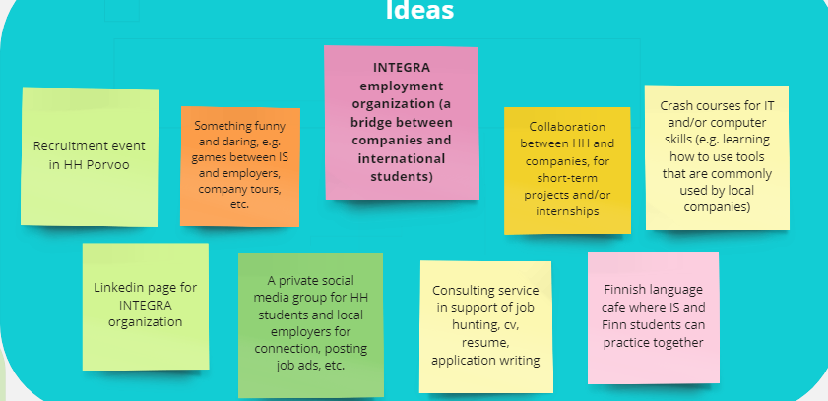
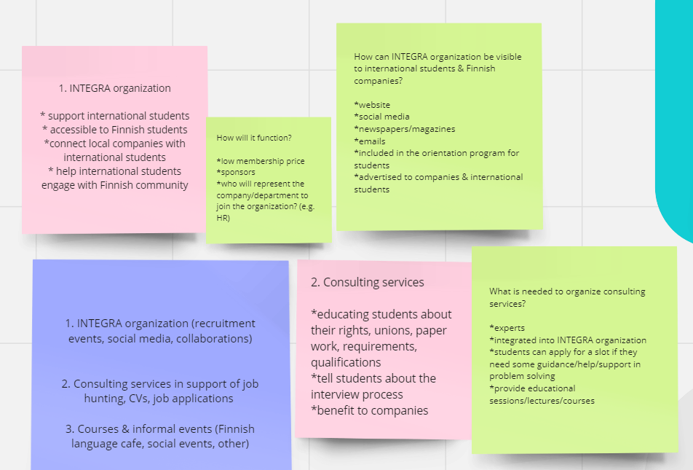
Ideation
During our brainstorming session, we produced more than 15 ideas. In the beginning we wanted to quickly remove the junk so we focused on writing out everything that came to mind.
We remembered to pull down on our empathy switch and really think what would we as an international students want?
Activating our empathy helped immensely with the process.
After we ran out of good ideas, we quickly switch to upgrading and going into more detail on the ones we have already written down.
Some of our idea notes on Miro

Slide 14

Some of the most interesting ideas
In this slide we will list some of the most interesting and crazy ideas that might work. "Crazy" because they are very unconventional. We believe that’s what makes them unique and probably very fun.
Number one: Students change places with an employee of a company (for a week).
This idea behind this is establishing trust. The company employee is going to see and experience the education that Haaga-Helia provides.
The student will experience company life, but not only that. In our opinion, the best thing that they will get from this experiment is knowledge. Not only in terms of a skillset, but also the students will see if they like the job, the position or the company.

Slide 15

Some of the most interesting ideas
Second: a crash course implemented by a Senior / Junior employee of a Porvoo based company.
Example:
They will get a classroom in the campus and one hour with a certain bachelor degree group (DIGIBBA)and teach them the basics of Excel or a soft skill like - how to share and convey your ideas efficiently.
In this way the employee will see how the students of Haaga-Helia behave and act and get to know them. This will create a rapport between the employee's company and Haaga-Helia.
Also, it will be a great opportunity for the students to see if that's a direction they want to go in – by seeing what and how and employee works in the real world.

Slide 16

Some of the most interesting ideas
Third: a Haaga-Helia English Work App. That is a long title, so let's call it HHWP.
This app has a lot of potential. It can be marketed as a perk of being a Haaga-Helia student and how no other UAS has it.
It can attract a lot of international talent to Finland and to also keep it.
Now, for an international student this app will be a game changer. The competition among the students will rise and theoretically their efforts and grades in the courses will rise as well. (so that they have a bigger chance to get a job)
How is this app any different than the other platforms? (Monster, Jobteaser, etc.)
It will be the only UAS english job app in Finland. It will be exclusive for Haaga-Helia international students. It will attract and keep talent from all over the world. Here is a quick slogan: Haaga-Helia English Job App – Get your education and jump into your dream career!

Slide 17
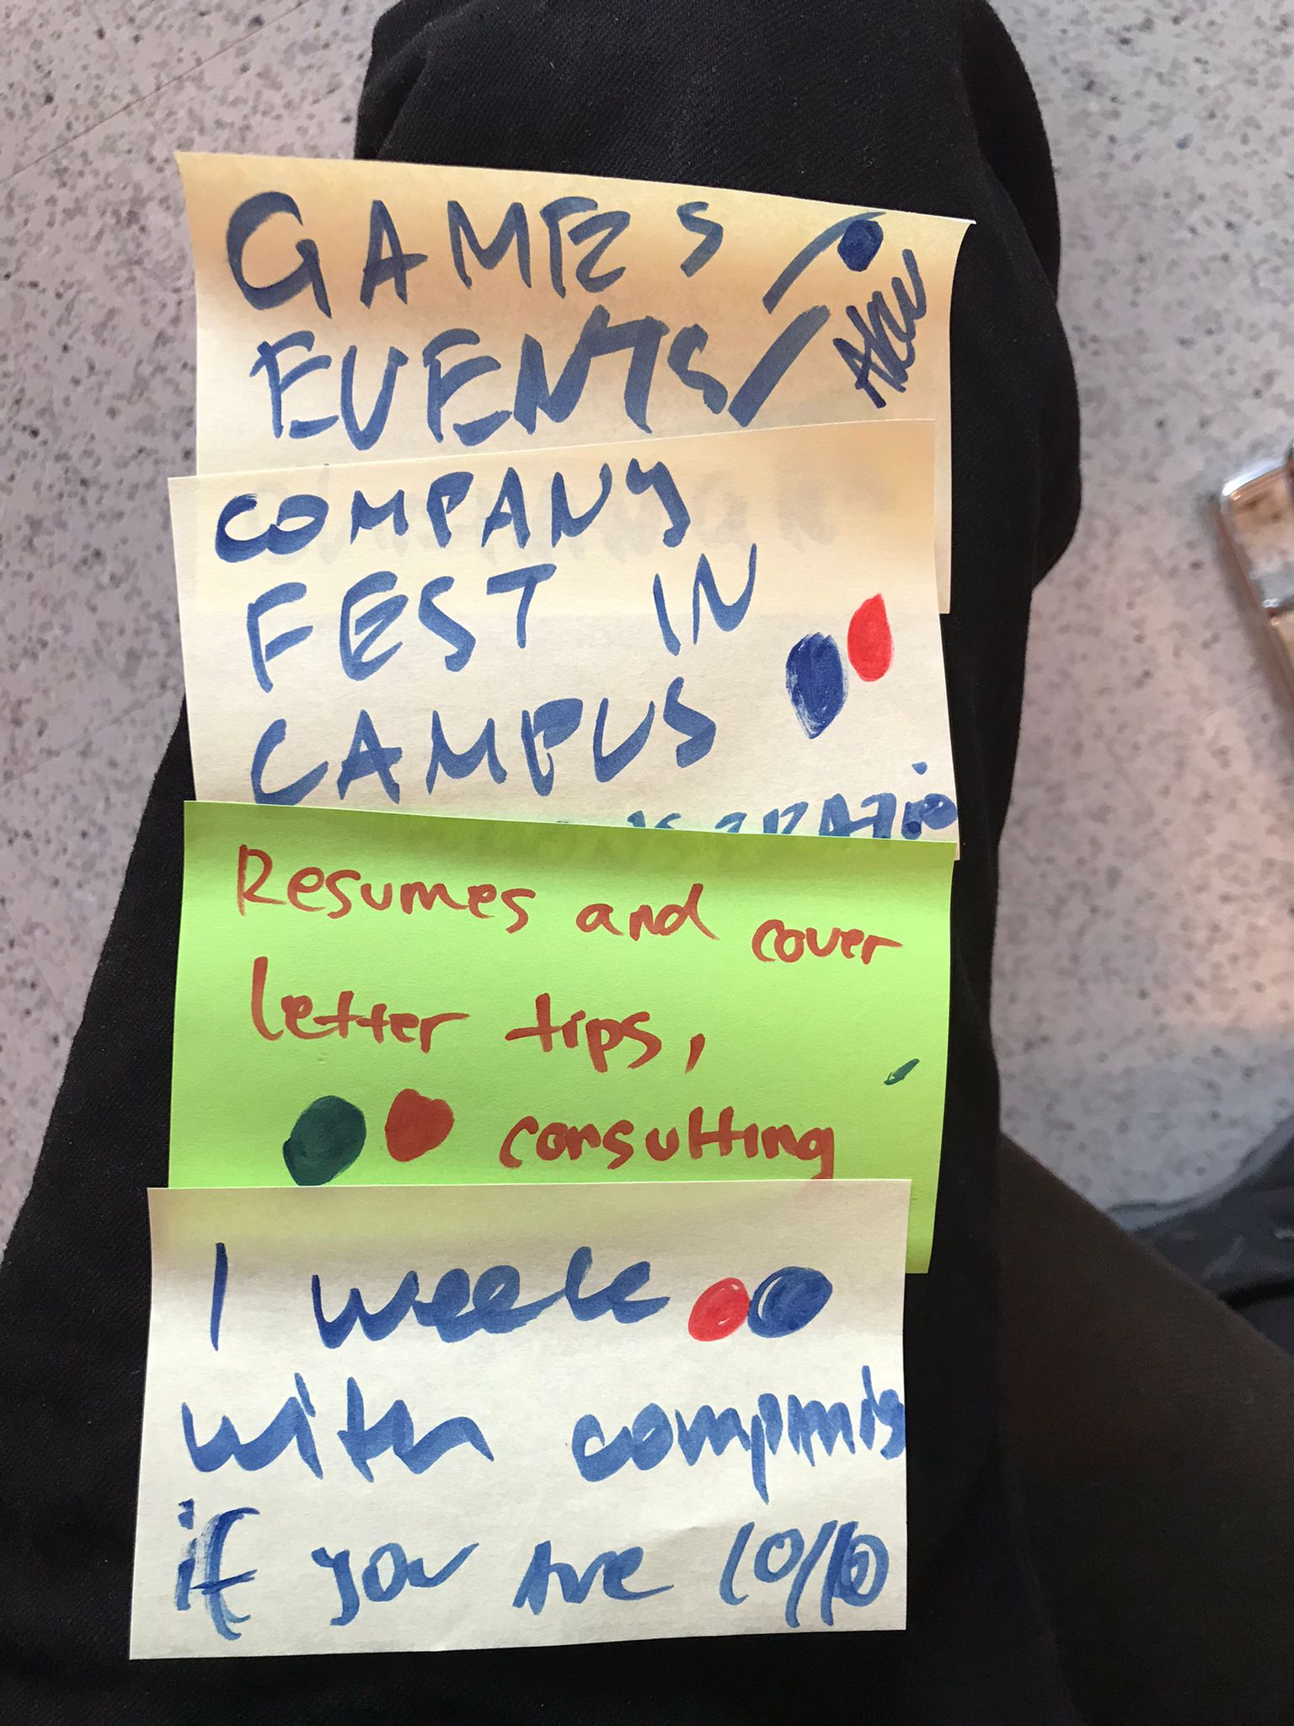
Elimination and filtering
After almost 15 minutes of non-stop thinking and discussion, it was time to step back and analyze what we have actually written down.
We decided to start the elimination process with questions. Some of the questions were – Is it achievable in the next 6 months? Is it going to be hard to organize? Is it going be expensive?
After filtering everything unnecessary we were left with those 3 ideas.
1. Gamifying events in Taidetehdas or Porvoo campus where companies and students get to interact with one another.
2. Companies to come and help students with their CVs and skillsets.
3. International students can win 1 week internships if they have good grades.

Slide 18
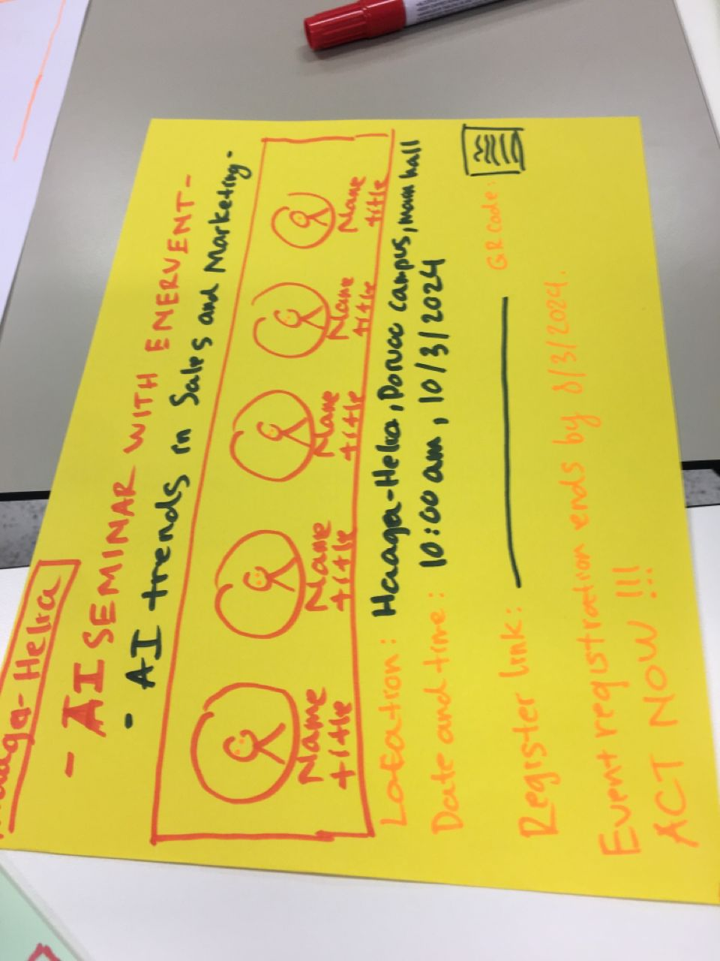
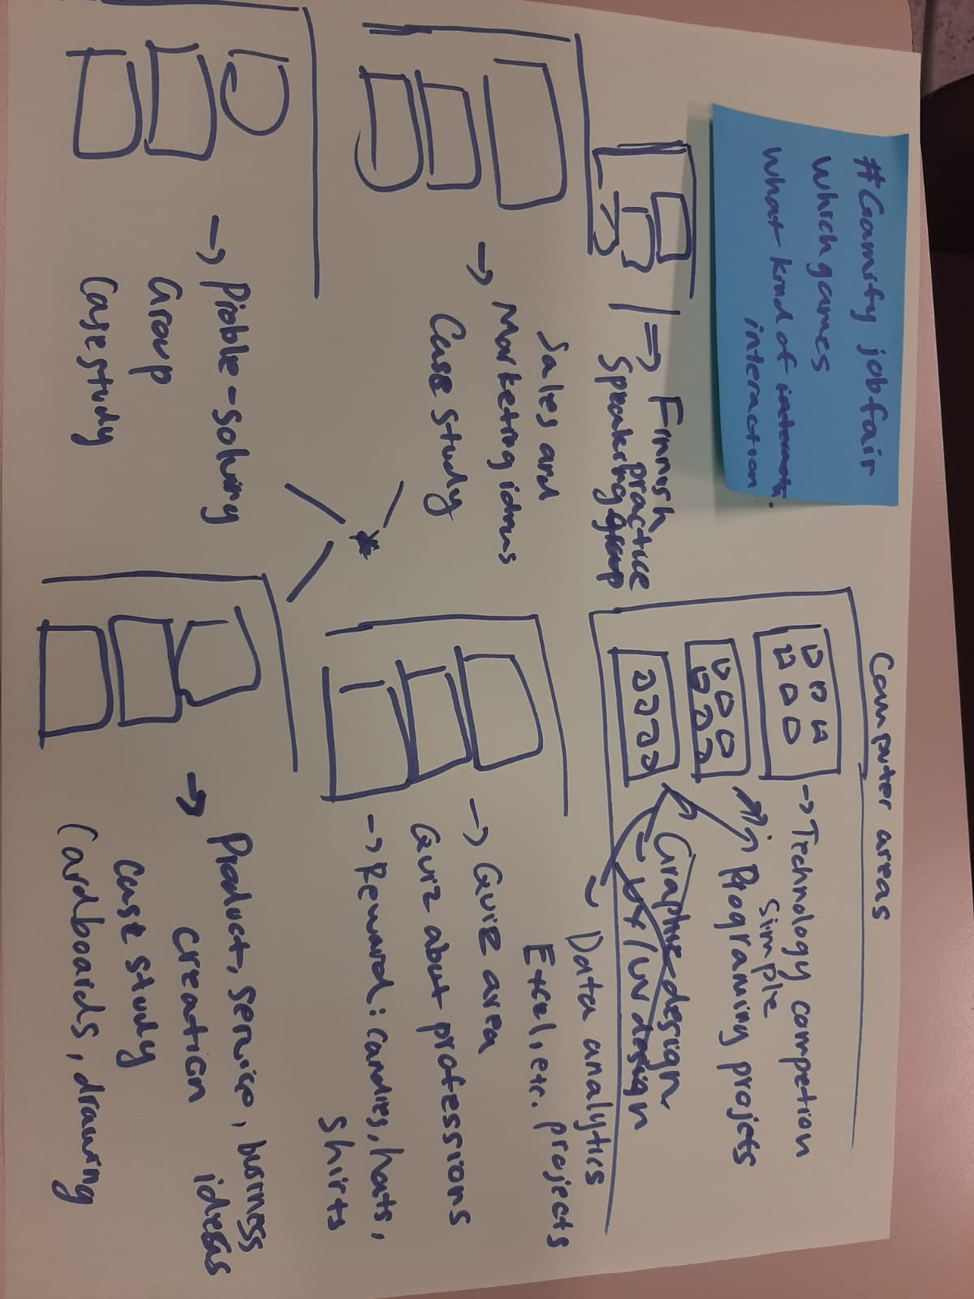
Testing
Prototyping for a seminar brochure
We tested our ideas first with only international students.
We made the survey with Webropol and made sure that the questions are simple and in English.
We didn’t test the ideas with the companies. We ran out of time.
** Correction
After the presentation feedback we reached again to the organizations asking them for their opinion and feedback. Unfortunately, they didn’t reply.
Prototyping for a gamified job fair

Slide 19
Prototypes
Things we learned from prototyping are....
User Feedback – We learn how to gather feedback from the user.
Iterative Improvement – We iterate on our design based on feedback and testing results. This iterative process leads to continuous improvement and a better product.
Cost-Effectiveness – Identifying and resolving issues during the prototyping stage is less costly than making changes after full development. Prototypes help us minimizing risks and reducing overall development costs.
Time Efficiency – Prototyping helps us in saving time by quickly testing ideas and concepts, making necessary adjustments, and moving forward in the design process without major setbacks.
Functionality Testing* – Prototypes helps us in testing the basic functions of a product or design to ensure they work as intended. This allows for identifying and fixing any issues early in the development process.
Visualization – We learn to visualize the end product, allowing stakeholders to better understand the design concept and make informed decisions.

Slide 20

Final solutions
Our final solutions......
Finnish Café - Creating Finnish café for the local and international students to break the bridges between them. This will give the international students a chance to learn more about Finnish culture and make Finnish friends.
Seminar with Finnish companies and international students – Creating seminar for international students will give them the opportunities to know what Finnish companies require from them when they apply for jobs.
Job fair with games – Adding games to job fair and/or recruitment event to make it fun, for example, trivia quiz game, treasure hunt game, etc.
Casual workshops with Finnish students – Helping international students to broaden their network and integrate more in Finnish community.

Slide 21
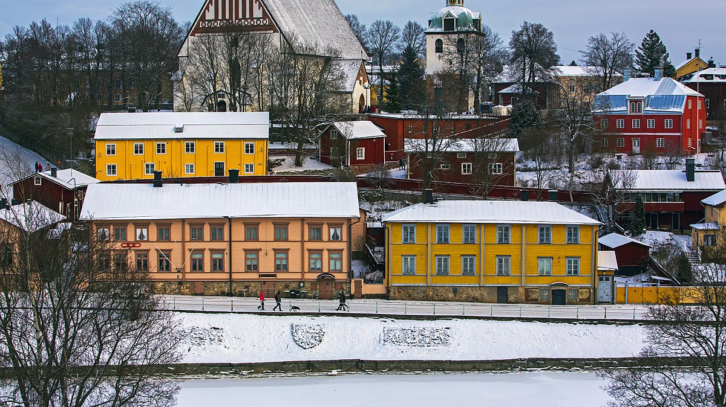
THANK YOU!

